Slide 1
Long live the KINGO
Computer Graphics T1
#Tanks #Kingo Kingo Eskara Kingo #Harder than it looks
붉은 융단 떼거리 2014312455 도경회
2014000000 이진욱

Slide 2
Table of Contents
Game Philosophy
Game Guidelines
Game Demo

Slide 3

1.
Game Philosophy
Ideation, Storylines and Explanations

Slide 4
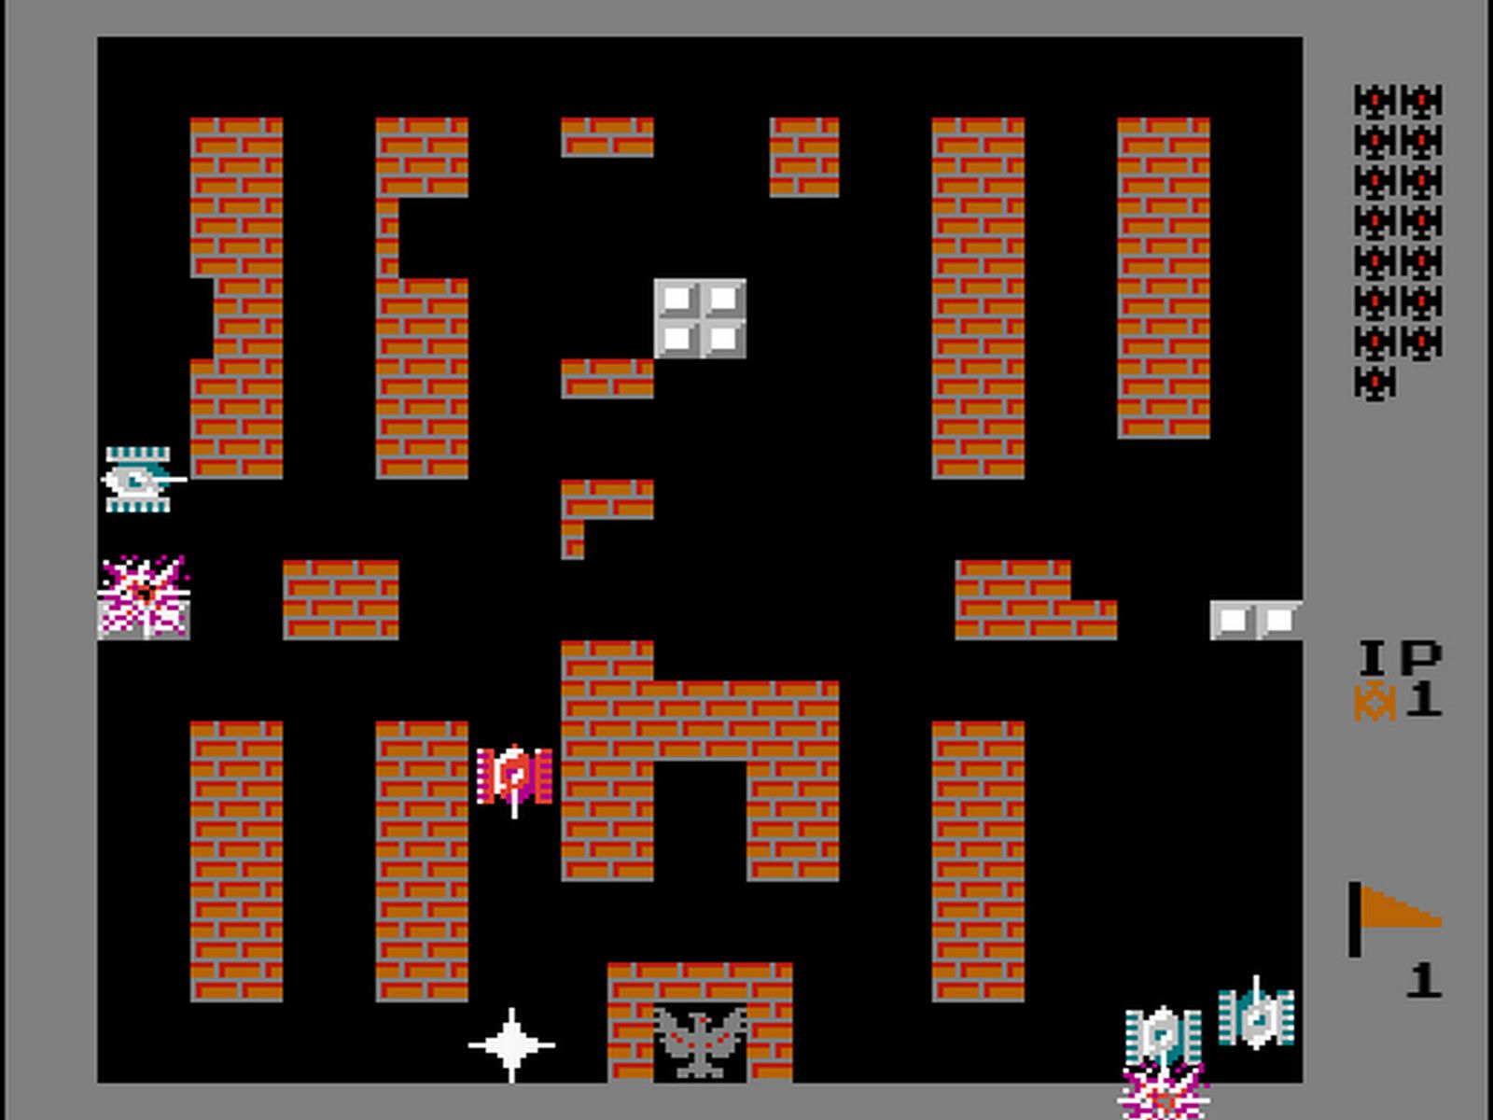
Game Philosophy
Ideation, Storylines and Explanations
Ideation from Battle city(1985)
- Tanks move around the map - Tanks fire bullets - Tank explodes after getting multiple shots - There are walls - Can break brick walls, but cannot break Iron walls
- Wins to defeat all enemy
- Loses if you or base explodes
- Since we are SKKU students, we save SKKU

Slide 5
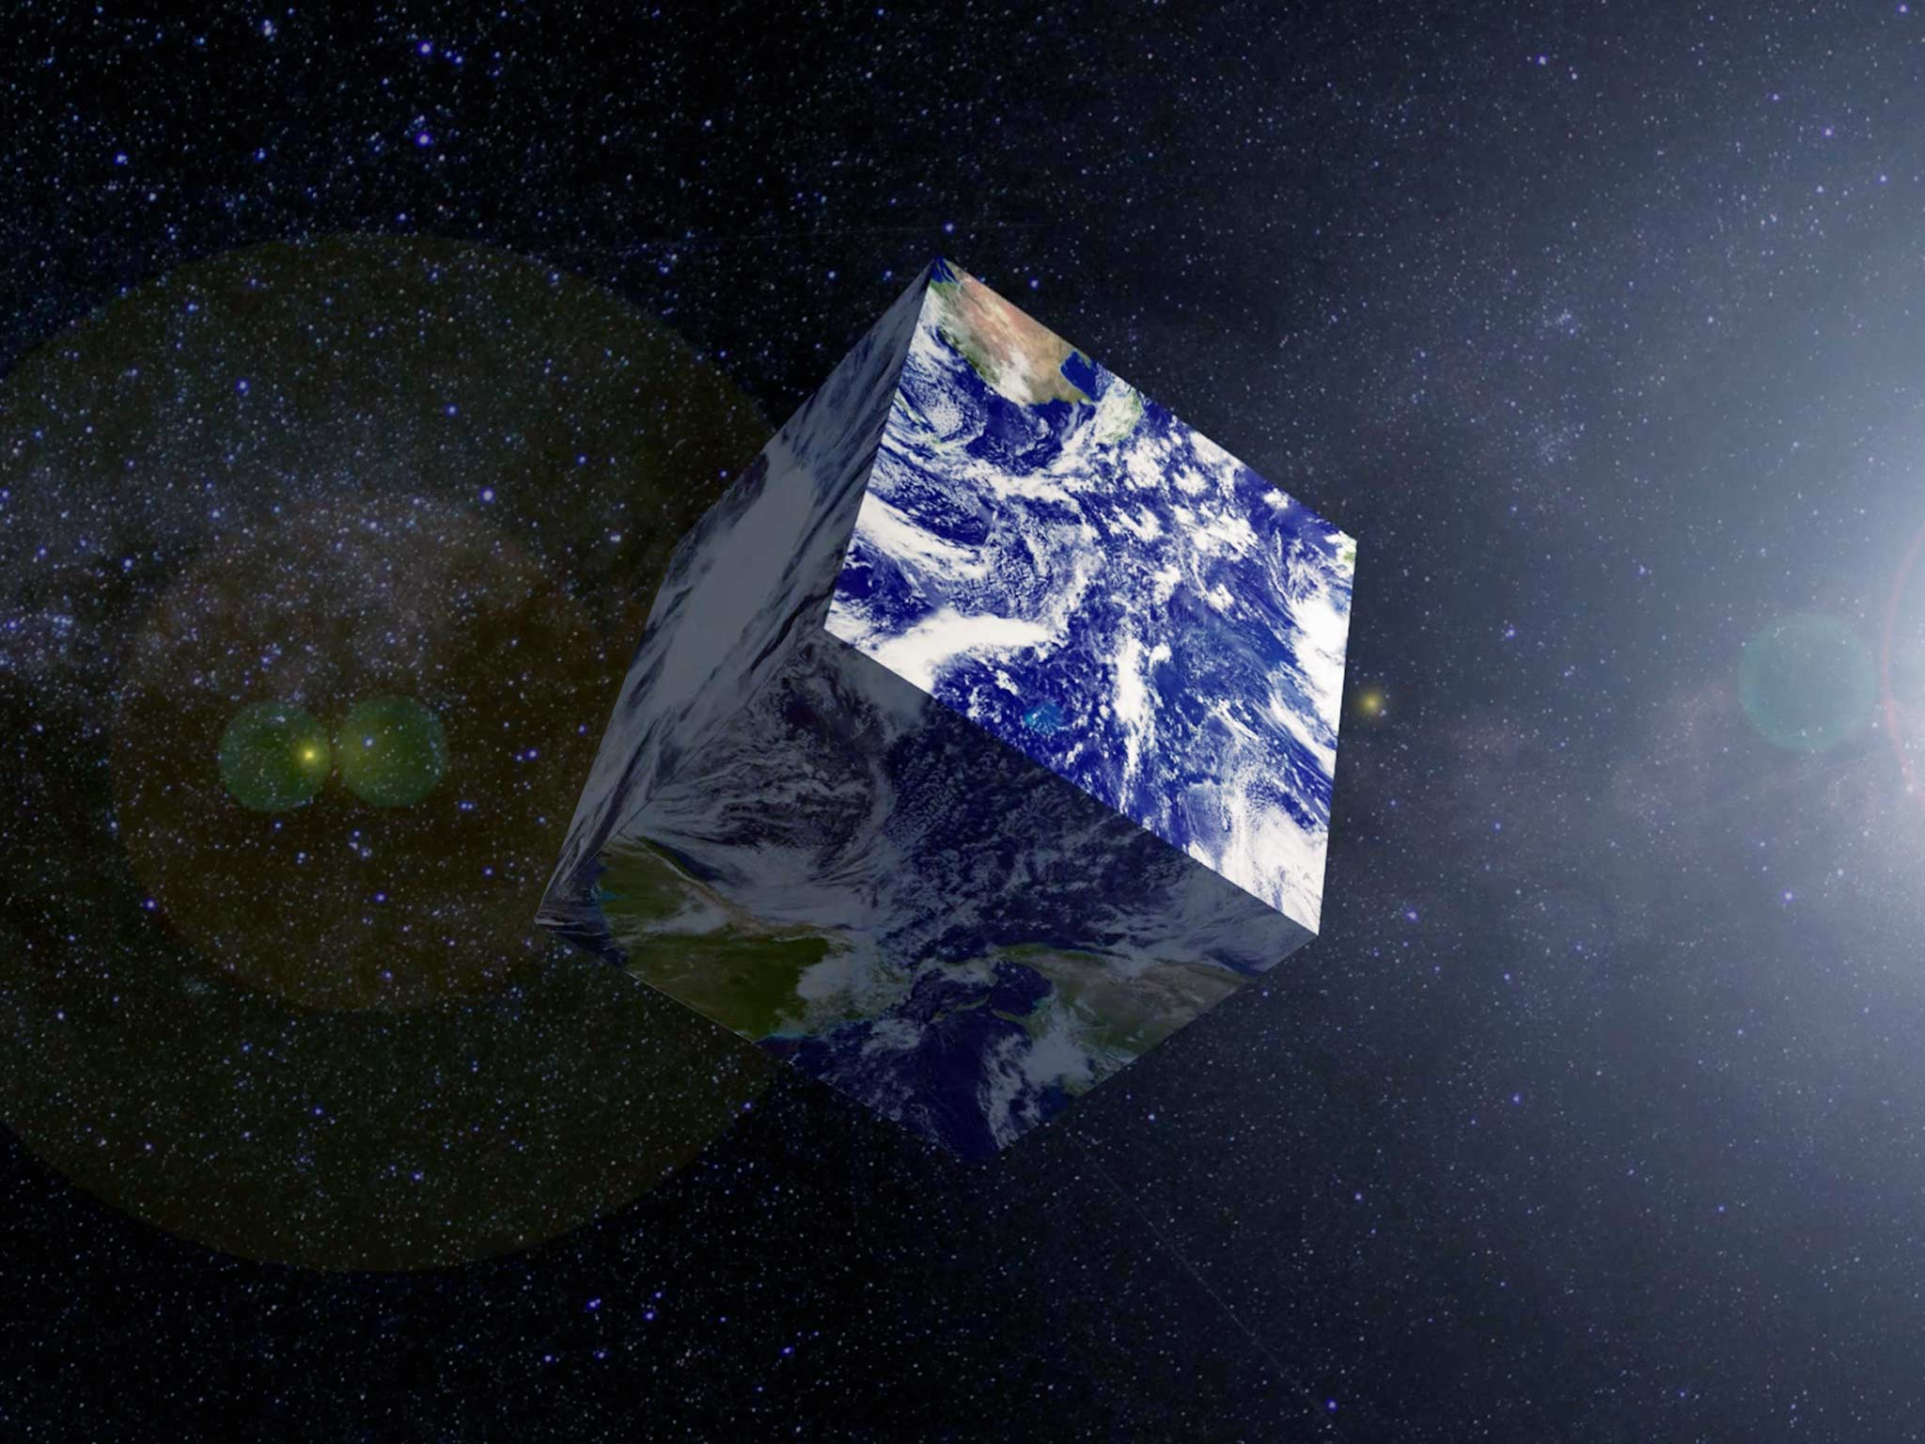
Game Philosophy
Ideation, Storylines and Explanations
Cube shaped Planet
- We can move around the planet - Move directions differ based on hemisphere - Since it is a planet, Physic rules are applied - Tanks are pushed out a little after getting shot - Bullets Reflect when it hits slanted iron - Gravity keeps object stick to the planet
- Once bullets fly out of atmosphere, they refract - Unknown pressure crushes refracted bullets

Slide 6

2.
Game Guidelines
Keyboard, mouse and Strategy

Slide 7
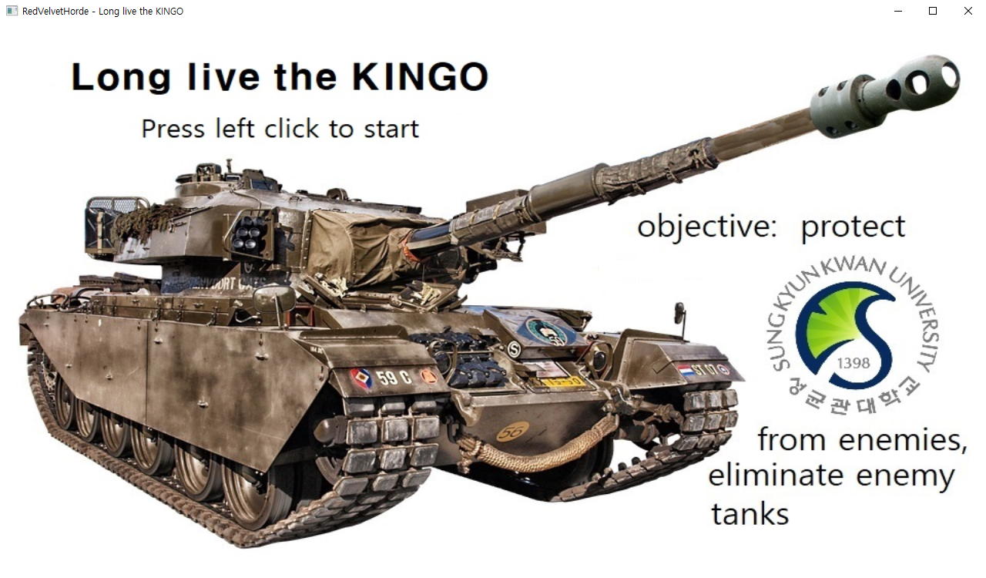
Game Guidelines
Keyboard, Mouse and Strategy
<Intro screen>

Slide 8
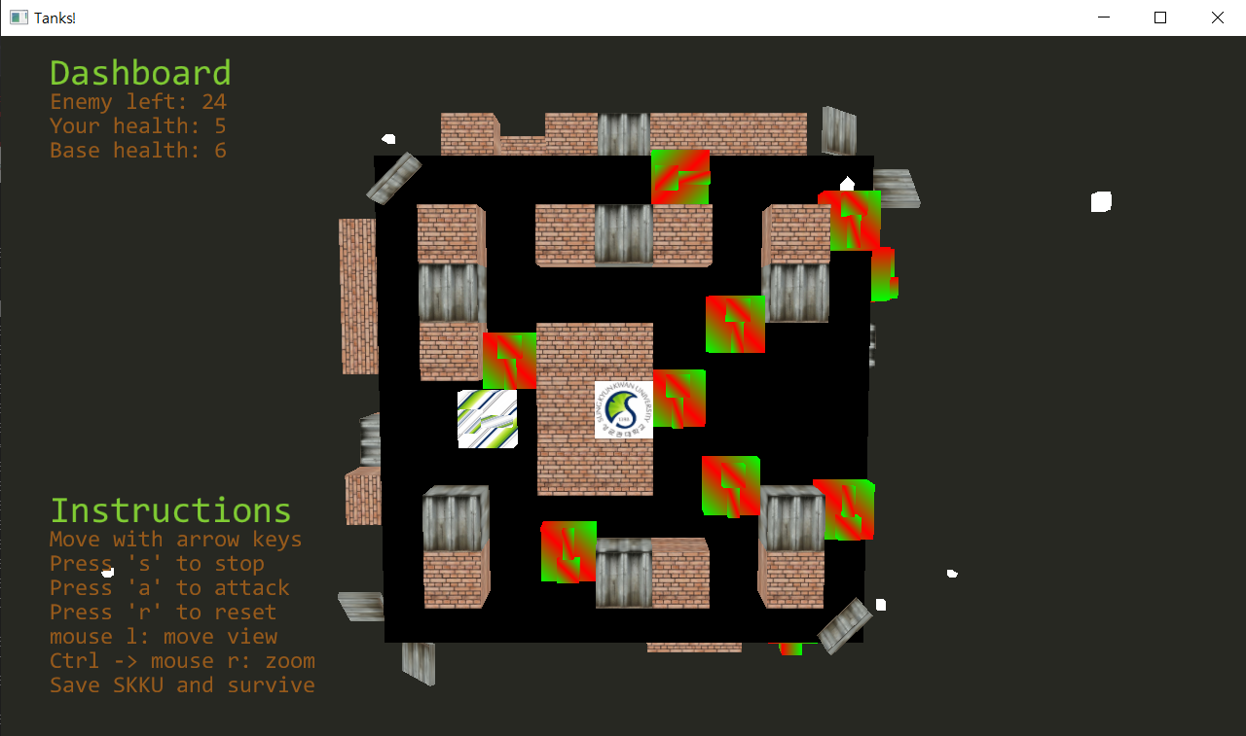
Game Guidelines
Keyboard, Mouse and Strategy
<In game screen>

Slide 9
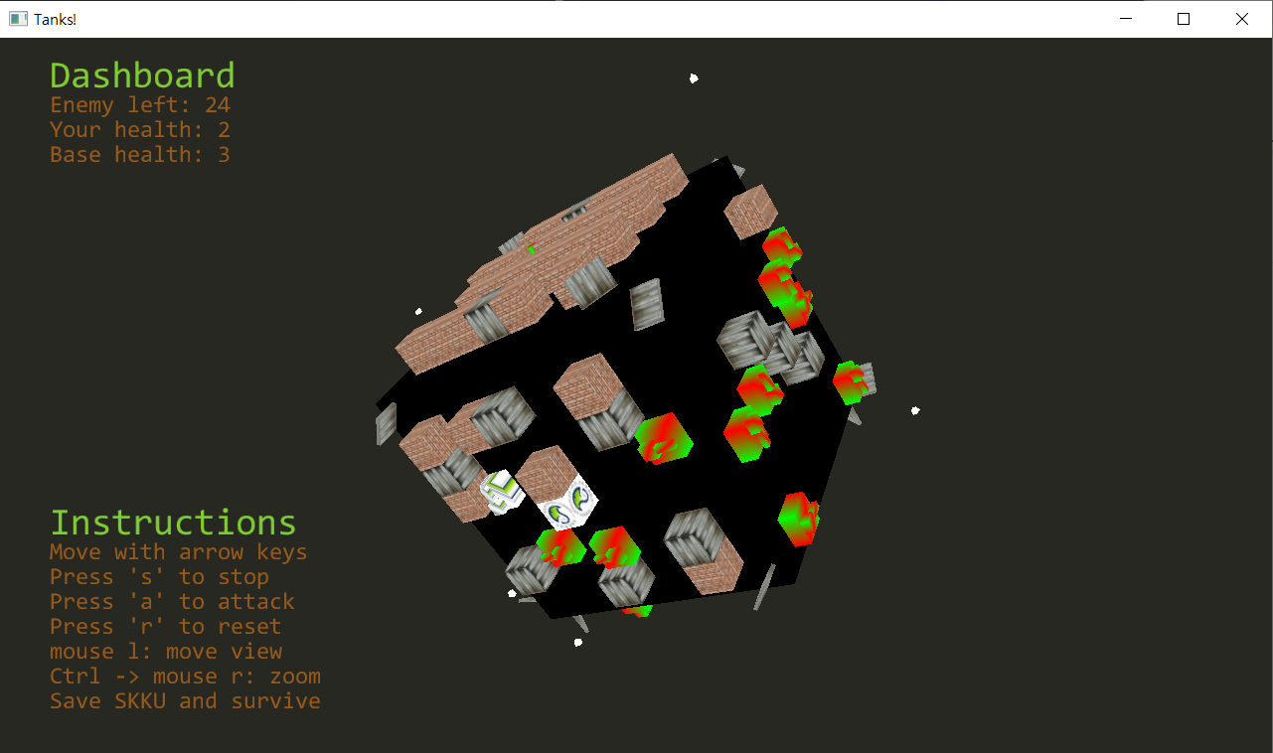

Game Guidelines
Keyboard, Mouse and Strategy
<In game screen>

Slide 10
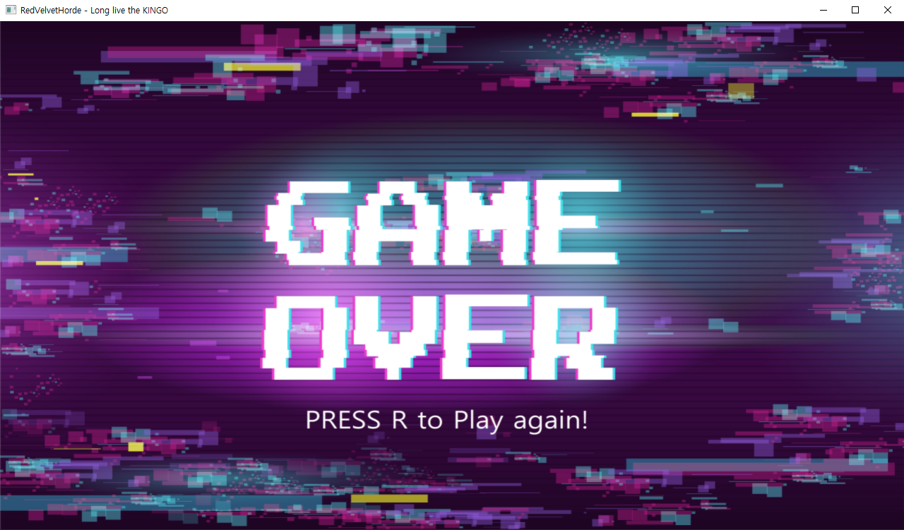
Game Guidelines
Keyboard, Mouse and Strategy
<Lose status screen>

Slide 11
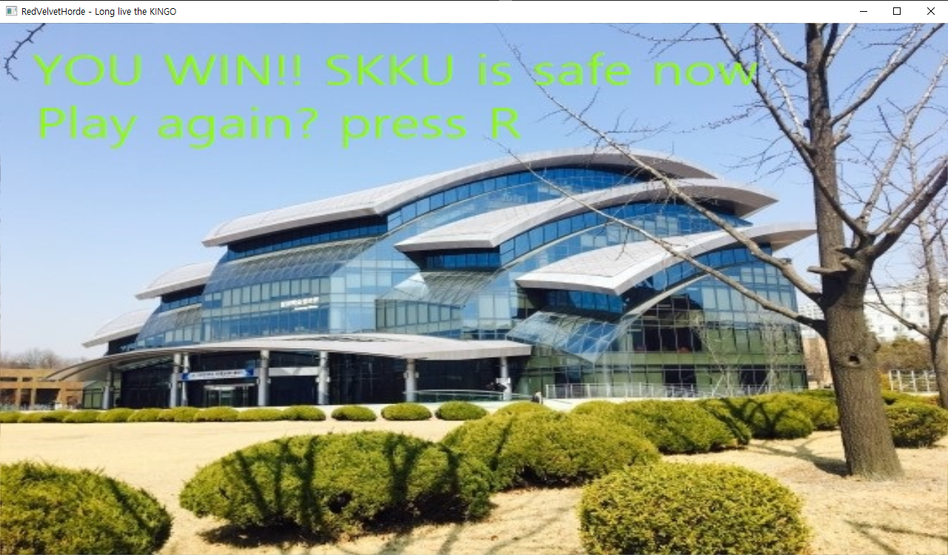
Game Guidelines
Keyboard, Mouse and Strategy
<Win status screen>

Slide 12
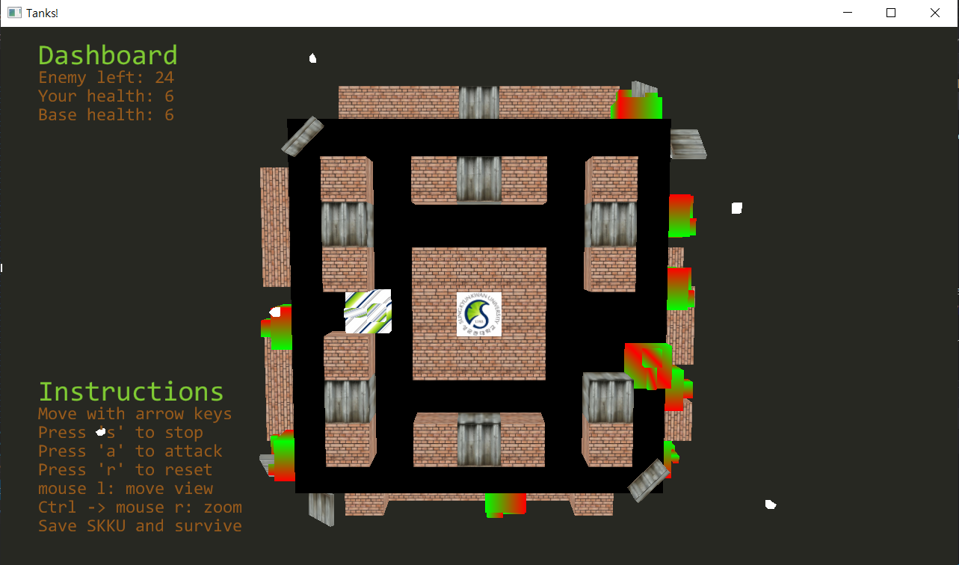
Game Guidelines
Keyboard, Mouse and Strategy
<Hide and shoot>

Slide 13
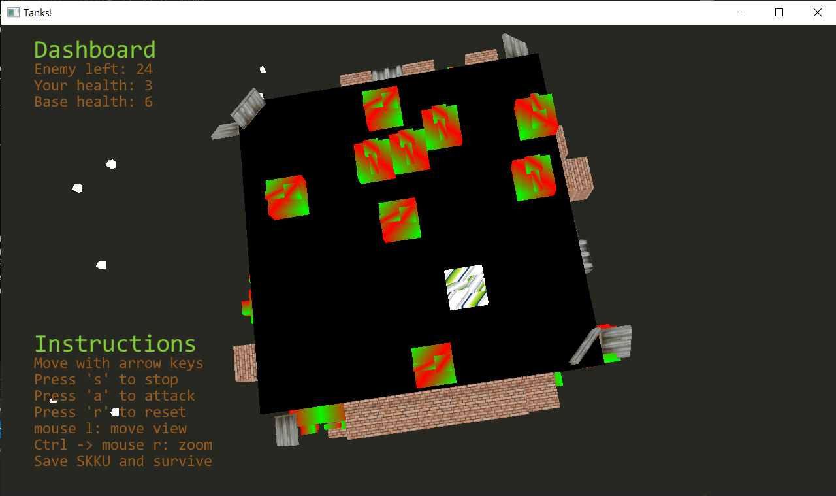
Game Guidelines
Keyboard, Mouse and Strategy
<Like a Boss>

Slide 14

3.
Game Demo
Winner Winner Chicken Dinner?

Slide 15
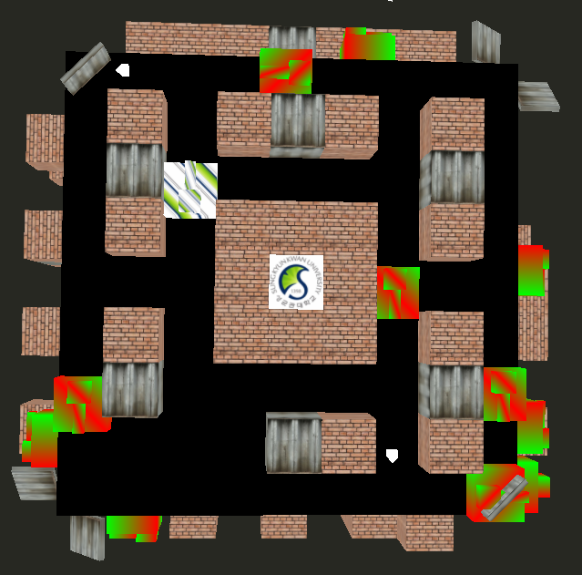
Game DEMO
Gameplay video

Slide 16

Computer Graphics T1
Thank you for listening!
Stay Safe, Stay Strong
RedVelvet-CG/termproject

